Slide 1
tail odds at U vs N

Slide 2
case
mod size 4.4 edge to edge for ~N(0,1)
when A not fixing the data we will get U dist
we can use kurtosis or check estimated STD, but here we look only on the tail

Slide 3
lets look at the tails of 10% of the modulo
for modulo of 8.8 edge to edge:
the odds for U to get samples at the tails is 20%
the odds for N is x>3.96 is
for 5 samples:
U: 1-0.8^5=0.672
N: 1-0.956^5=0.878
error detecting N when it’s U:
all U are under threshold: 67%
error detecting U when it’s N:
at least 1 sample of 5 is outside threshold: 88%

Slide 4
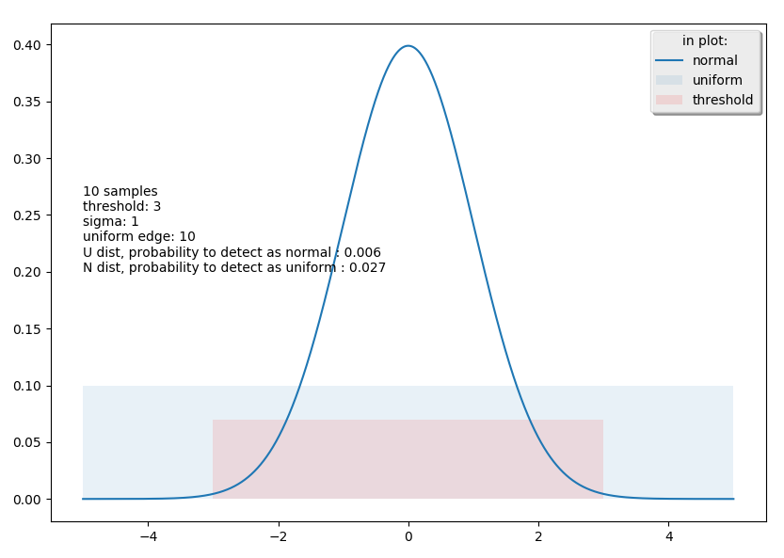
and 20% with 10 samples
import scipy.stats as st import pylab as plt import matplotlib.patches as patches import numpy as np def errors(u_size, threshold, n_std, samples): ''' when you have inside threshold, you point N and outside you point U ''' # u_error means that you have u and you dont have samples outsize the threshold u_error = (threshold * 2.0 / u_size) ** samples # n_error means that you have n and you have samples outsize the threshold n_to_be_outsize = (1 - st.norm(0, n_std).cdf(threshold)) * 2 n_error = 1 - (1 - n_to_be_outsize) ** samples return u_error, n_error samples = 10 modulo = 10 sigma = 1 threshold=3 u_error,n_error=errors(modulo, threshold, sigma, samples) U_N_errors="%d samples\nthreshold: %.02g\nsigma: %.02g\nuniform edge: %.02g\nU dist, probability to detect as normal : %.02g\nN dist, probability to detect as uniform : %.02g"%(samples,threshold,sigma,modulo,u_error,n_error) print(U_N_errors) fig1 = plt.figure() ax = plt.gca() x_axis = np.arange(-5 * sigma, 5 * sigma, 0.001) plt.plot(x_axis, st.norm.pdf(x_axis, 0, sigma),label="normal") ax.add_patch(patches.Rectangle((-modulo / 2.0, 0), modulo, .1, alpha=0.1,label="uniform")) ax.add_patch(patches.Rectangle((-threshold, 0), 2*threshold, .07, alpha=0.1,facecolor="red",label="threshold")) plt.legend(loc="best",ncol=1, shadow=True, title="in plot:") plt.text(-5 * sigma,0.2,U_N_errors) plt.show()

Slide 5
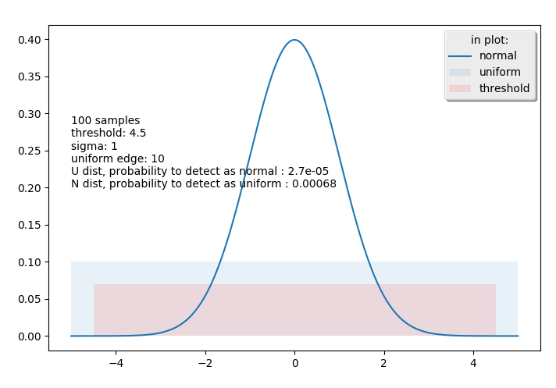
more samples
as we take more samples, we will be better at U but worse at N
to compensate this, we will take larger threshold

Slide 6
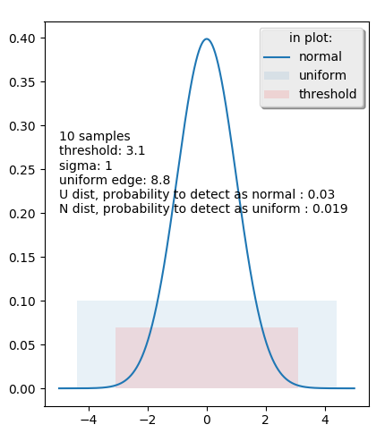
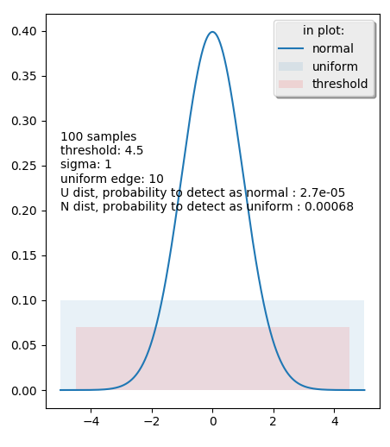
our module std ratio is 8.8:

Slide 7
errors vs threshold

Slide 8
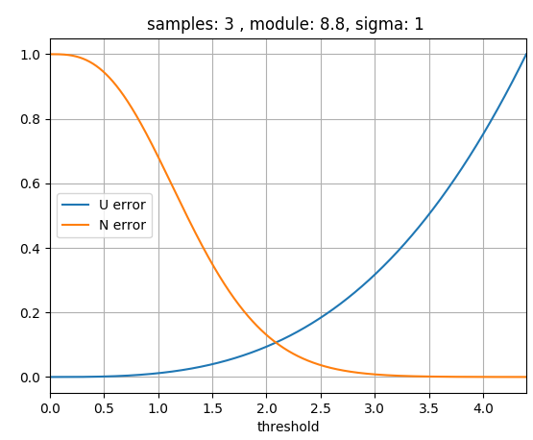
3 samples

Slide 9
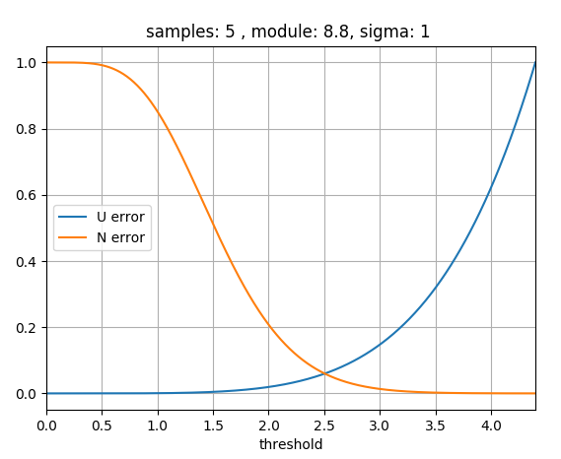
5 samples

Slide 10
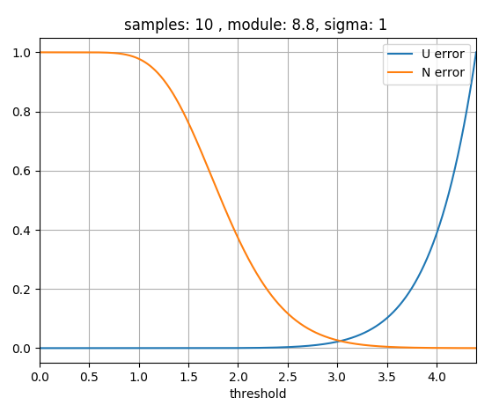
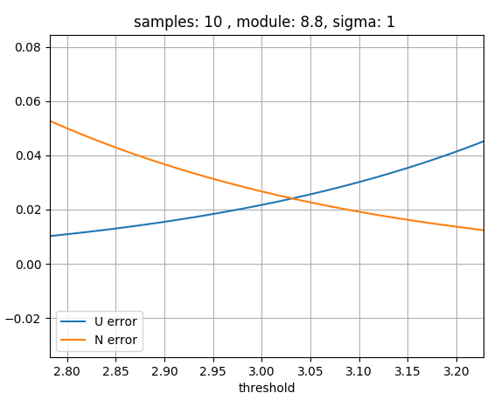
10 samples

Slide 11
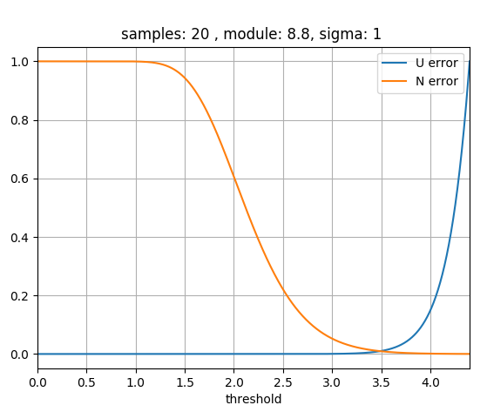
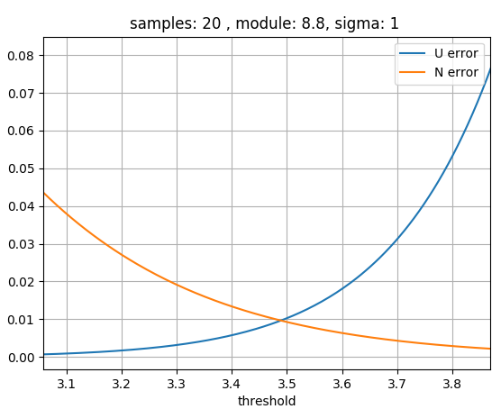
20 samples

Slide 12
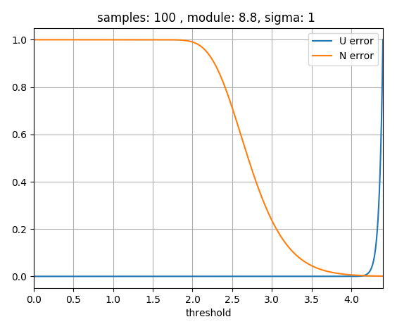
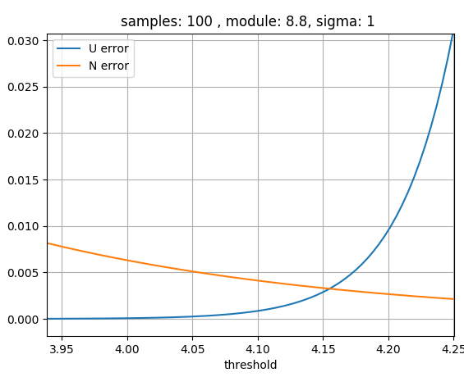
100 samples

Slide 13
variance of estimated STD at U and N

Slide 14
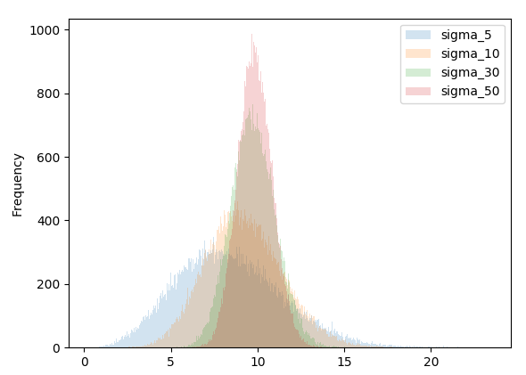

at N: $\frac{\left(n−1\right)s^{2}}{σ^{2}}∼χ_{n−1}^{2}$

